Slide 1
RESUME BUILDER
su
Under the supervision of
Dr. Anup Dey
Associate Professor School of
Computer Science & Artificial Intelligence
Presented for
Milestone 3-Final Minor Project Review
Date:26-04-2024
Candidate No. & Name
HTNO. | Name
2203A51L76 2203A51L70 2203A51L68 2203A51L81 2203A51L05 | CH .NANDA SAI P.LOKESH Y.SRINITHA P. RADHIKA A. SMINU

Slide 2
Outline of the presentation
1 . ABSTRACT
2. OBJECTIVE
3. INTRODUCTION
4. LITERATURE SURVEY
5. EXISTING SYSTEM
6. DISADVANTAGE
7. GAPS IDENTIFIED
8. PROBLEM IDENTIFICATION
9. PROPOSED METHODOLOGY
10. ALGORITHM

Slide 3
Outline of the presentation
11 .IMPLEMENTATION
12 . COMPARATIVE STUDY OF PROPOSED AND EXISTING SYSTEM
13 . FUTURE SCOPE
14 . REFERENCE
15 . CONCLUSION

Slide 4
Abstract
The Resume Building Project is aimed at developing a user-friendly web application to assist individuals in creating professional resumes efficiently. In today's competitive job market, having a well-crafted resume is essential for showcasing one's skills and experiences effectively.
The project will utilize modern web development technologies such as HTML, CSS, JavaScript,
he A will offer a streamlined interface where users can input their personal information, education background, work experience, skills, and other relevant details.
By providing a user-friendly platform for resume creation, this project aims to empower individuals in presenting themselves effectively to potential employers, ultimately increasing their chances of securing desired job opportunities.

Slide 5
Objectives -
Objective 1
Enhance Resume Effectiveness : Develop a structured approach to creating a resume that effectively highlights your skills, experience, and achievements.
Objective 2
Optimize for Applicant Tracking Systems : Ensure your resume is formatted and optimized to pass through automated screening processes.
Objective 3
Showcase Your Uniqueness : Develop strategies to make your resume stand out and showcase your personal brand.

Slide 6
Introduction
An application that simplifies the task of creating a resume for individuals. The system is flexible to be used and reduces the need of thinking and designing an appropriate resume according to qualifications. The system is developed to provide an easy means for creating a professional looking resume. Individuals just have to fill upIt is a form that specifies questions from all required fields such as personal questions, educational, qualities, interest, skills and so on. The answers provided by the users are stored and the system automatically generates a well structured resume. Users have option to create resume in any format and file.

Slide 7
Existing system
Focuses on work history in reverse chronological order.
Chronological
Emphasizes skills and achievements rather than job titles.
Functional
Blends elements of chronological and functional formats.
Combination

Slide 8
Literature Review
Academic Research
Industry Insights
Peer Experiences
Studies have explored the psychology of resume evaluation and the impact of specific formatting choices.
Hiring experts and career coaches have published numerous articles and guides on crafting effective resumes.
Online forums and communities provide valuable peer-to-peer advice and real-world examples.

Slide 9

Disadvantages
Lack of Customization
Traditional formats may not effectively highlight relevant skills and experiences for specific job roles.
Limited Optimization
Existing approaches may not be optimized for automated screening by Applicant Tracking Systems (ATS).
Insufficient Differentiation
Standard resume formats can make it challenging to stand out in a crowded job market.

Slide 10
Research gap identified
Template Variety and Customization: Another gap might be the lack of variety and customization options in the generated resume templates. Users have diverse preferences and industry standards, so providing a wide range of templates and robust customization features would enhance user satisfaction and the effectiveness of the resumes generated.
Data Security and Privacy: If the resume builder collects and stores sensitive user information, gaps in data security and privacy could pose significant risks. Implementing robust security measures, encryption protocols, and compliance with data protection regulations (e.g., GDPR, CCPA) would be essential for mitigating this gap and building trust with users.
Feedback and Improvement Mechanisms: The absence of feedback mechanisms or tools for improving resumes could be a significant gap. Users may not be aware of best practices for resume writing or how to tailor their resumes for specific job opportunities. Implementing features such as automated feedback, suggestions for improvement, and access to resources or guides on resume writing would help address this gap.
resumes. A gap could arise if the resume builder does not integrate seamlessly with these systems or fails to generate resumes compatible with ATS. Ensuring compatibility and providing guidance on optimizing resumes for ATS would be essential.

Slide 11
PROPOSED METHODOLOGY
Methodology
Project Planning and Analysis: Define project objectives, scope, and target audience . Conduct market research to understand user needs and competitor offerings . Create user personas to represent the target audience and their requirements . Identify key features and functionalities based on user research and business goals . Define success criteria and project milestones.
Gathering:
Gather detailed requirements for each feature identified during the analysis phase . Document functional and non-functional requirements . Prioritize requirements based on their importance and feasibility.
Design Phase:
Design the system architecture, including database schema, backend APIs, and frontend components . Create wireframes or mockups to visualize the user interface and user experience . Define data models and relationships for storing user profiles and resumes.
Development:
Implement the backend logic and APIs for user authentication, profile management, and resume creation . Develop the frontend application using appropriate technologies (e.g., HTML/CSS/JavaScript, React, Angular, Vue).

Slide 12
Problem identification
Lack of Customization
Traditional formats may not effectively highlight relevant skills and experiences for specific job roles.
Limited Optimization
Existing approaches may not be optimized for automated screening by Applicant Tracking Systems (ATS).
Insufficient Differentiation
Standard resume formats can make it challenging to stand out in a crowded job market.

Slide 13
Algoritham
Frontend Interface : HTML/CSS/JavaScript: These technologies are used to create the user interface (UI) of the web application
CSS Media Queries : Algorithms for responsive design ensure that the UI adapts to different screen sizes and devices.
Security Measures: Encryption Algorithms: Employed to secure sensitive data, such as user credentials and personal information
Input Validation: Algorithms for validating user input to prevent common security vulnerabilities, such as SQL injection and cross-site scripting (XSS) attacks.
Algorithms for Data Management: Algorithms for storing, retrieving, and updating resume data efficiently are implemented, ensuring fast and reliable access to user information .Authentication and Authorization
Word Document Generation (Optional): Algorithm to convert the rendered resume into a Word document. Libraries like docxtemplater or server-side tools can be used for this purpose

Slide 14
IMPLEMENTATION
Requirement Gathering: Understand the features users would want in a resume builder.
Design: Plan the layout, user interface, and database structure.
Development: Write code to implement the features and functionality.
Testing: Test the application thoroughly to ensure it works as expected.
Deployment: Deploy the application to a web server or cloud platform.
Key features could include :
User authentication
Template selection
Section customization (e.g., education, work experience, skills)Preview and download functionalityExport options (PDF, Word)Resume storage and management

Slide 15
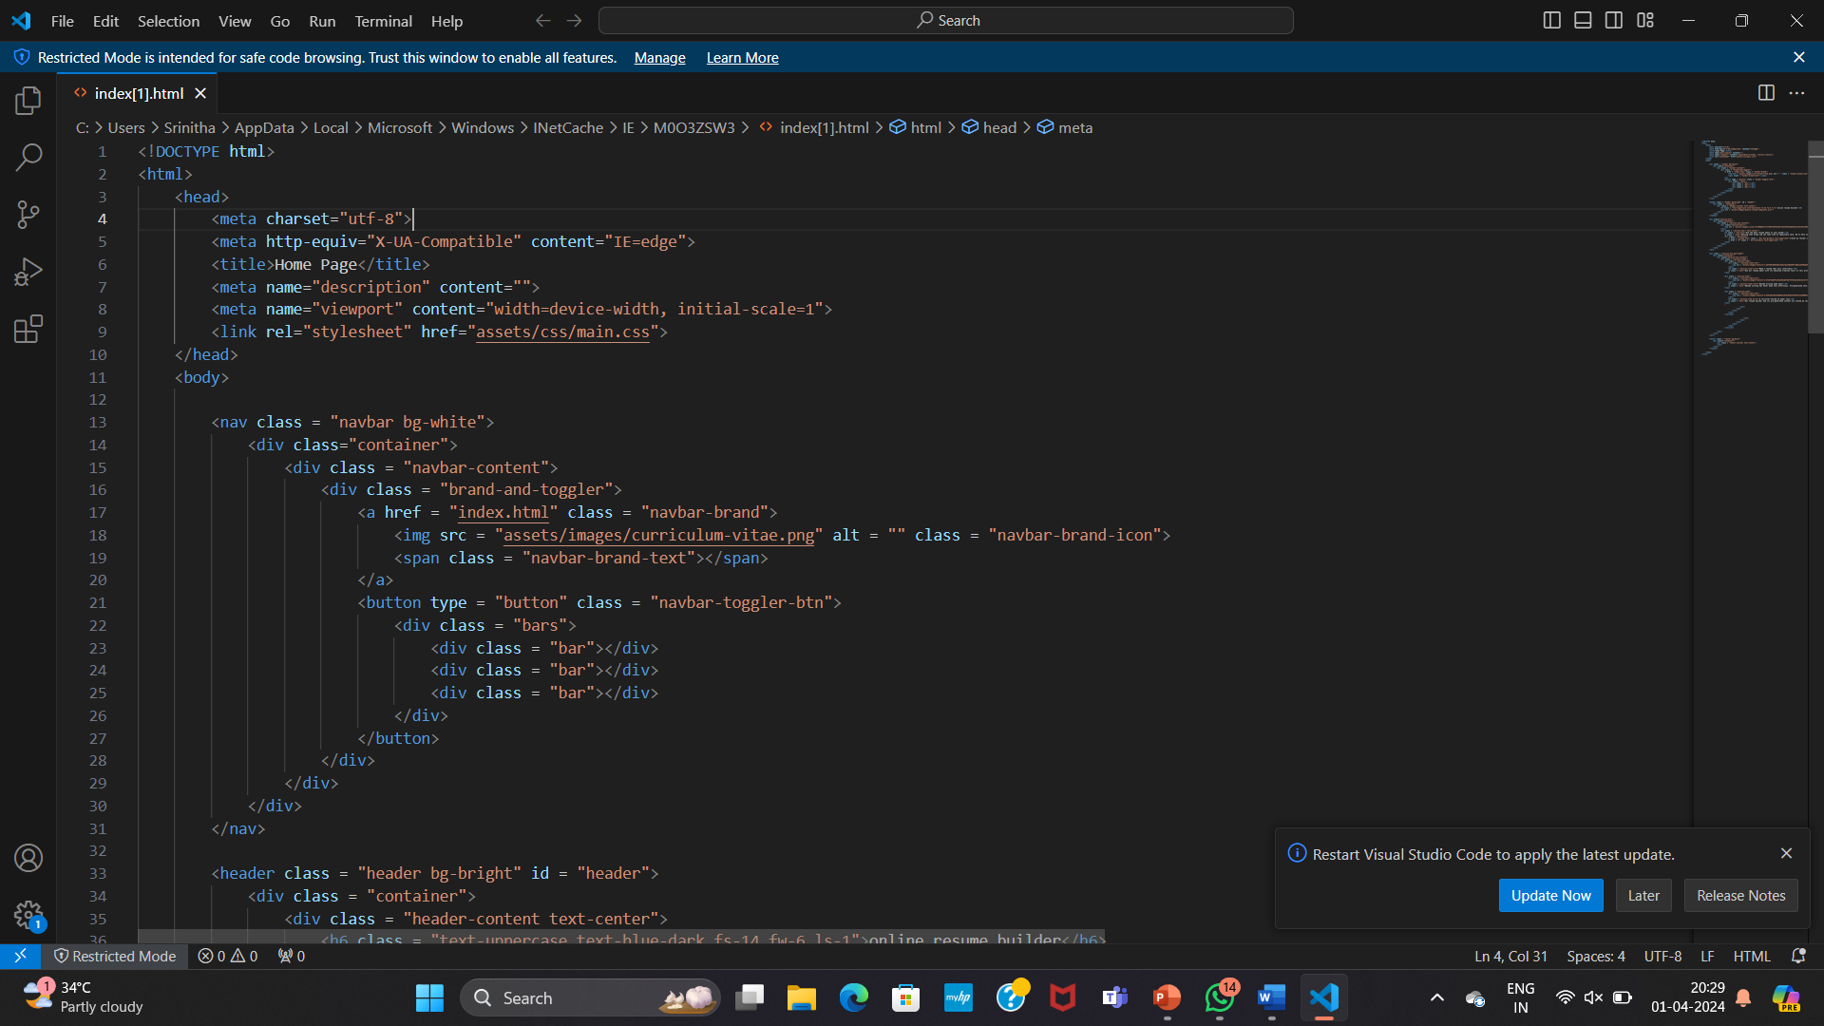
IMPLEMENTATION

Slide 16
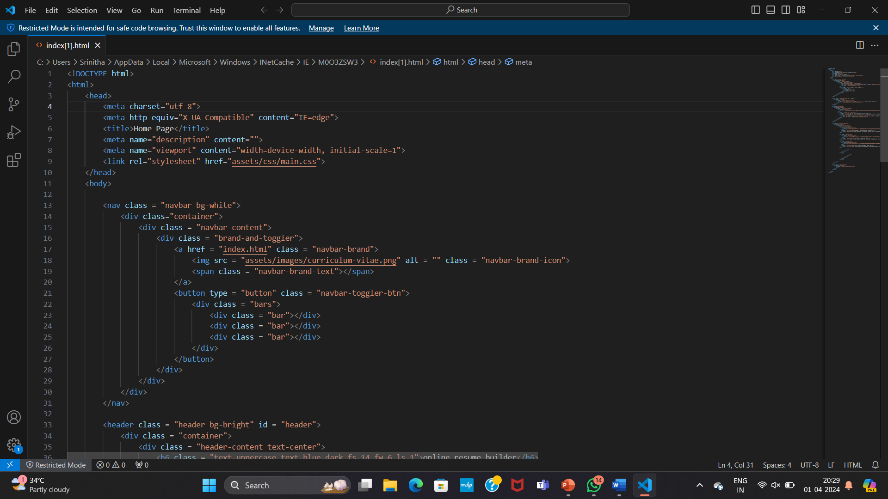
IMPLEMENTATION

Slide 17
Comparative study of proposed and existing system
User Interface: An intuitive interface where users can input their personal details, work experience, education, skills, etc. This interface could be a web application, mobile app, or both.
Data Storage: A database to store user information securely. This could be relational (SQL) or NoSQL, depending on the scalability and complexity requirements.
Template Generation: Algorithms to generate resume templates based on the parsed information. These algorithms would format the data into visually appealing and professionally structured resumes. They might include predefined layouts and designs, customizable sections, and styling options.
Personalization: Features to allow users to customize their resumes further, such as choosing different fonts, colors, layouts, and adding sections specific to their industry or career goals.
Validation and Feedback: Validation checks to ensure that the entered information is correct and complete. Feedback mechanisms could provide suggestions for improving the resume's effectiveness, such as adding more relevant keywords or rearranging sections

Slide 18
Future scope
Advanced Templates: Introduce more diverse and customizable templates to cater to different industries, career levels, and personal preferences. Consider adding templates optimized for specific job roles or sectors.
AI Integration: Incorporate artificial intelligence (AI) capabilities to provide personalized suggestions for content, formatting, and keywords based on the user's industry, experience, and job preferences. AI can also assist in identifying potential improvements for the resume.
Language Support: Expand language support to accommodate users from diverse linguistic backgrounds. This could include multilingual templates, translation features, or localized content recommendations.
Career Guidance: Offer additional resources and guidance to help users navigate the job search process effectively, such as interview tips, networking strategies, and career development resources.
Integration with Job Platforms: Forge partnerships with job search platforms or professional networking sites to enable seamless integration of resumes created using the builder. This could include one-click submission to job applications or automatic syncing of profile information.

Slide 19
References
[1] | Simple Resume Builder: A basic resume builder project on GitHub .Resume Builder Another open-source resume builder project with Flask backend and React frontend.
[2] | Build a Resume Template with HTML & CSS: A tutorial on creating a simple resume template using HTML and CSS
[3] | PDFKit: A JavaScript PDF generation library that can be used to generate PDF resumes.Articles and Blog Posts:

Slide 20
Conclusions
Reviewing the Final Product: Take a comprehensive look at the completed resume to ensure that all necessary sections are included, and the content is accurate, relevant, and well-organized.
Proofreading and Editing: Check for any grammatical errors, typos, or formatting issues. Ensure consistency in font styles, sizes, and spacing throughout the document.
Customization: Tailor the resume for specific job opportunities by emphasizing relevant skills, experiences, and achievements that align with the target position.
Seeking Feedback: It's always beneficial to have someone else review the resume for feedback. This could be a mentor, colleague, or professional in the field.
Final Adjustments: Incorporate any feedback received and make final adjustments to optimize the resume's effectiveness.
Saving and Distribution: Save the resume in an appropriate format (usually PDF) and ensure it's easily accessible for job applications, either through email attachments or online platforms.

